Slide 1
Candidate Entity Ranking

Slide 2
Candidate Entity Ranking
In some standard benchmark datasets (TAC-KBP2010,2011), entity mentions were linked on average to about 13 different entities in the Knowledge Base
Two types of methods:
Supervised Ranking Methods
Unsupervised Ranking Methods
How can we rank them?

Slide 3
Candidate Entity Ranking
In some standard benchmark datasets (TAC-KBP2010,2011), entity mentions were linked on average to about 13 different entities in the Knowledge Base
Another different classification:
Independent Ranking Methods: Assume mentions are independent
Collective Ranking Methods: Assume a document refers to coherent entities
Collaborative Ranking Methods: Leverage cross-document context to disambiguate
How can we rank them?

Slide 4
Features
What can we leverage in order to identify the correct mapping <mention, entity> (“Jordan”, en.wikipedia.org/wiki/Michael_Jordan)?
Two types of features:
Context-independent features, which just rely on the surface-form of the entity mention
Context-dependent features, which also look at the context around the entity mention

Slide 5
Features
Context-independent features
Name string comparison: We can simply check whether the mention and the entity label in the KB match
Exact matching
Dice coefficient score
Hamming distance
Combinations of the above

Slide 6
Features
Context-independent features
Entity popularity: Given a certain mention, pick the entity which is the most popular
One way to calculate popularity consists of using Wikipedia. Let E_{m} be the set of potential entities, e_{i} is a candidate entity and e_{m} the entity mention
count_{m} is the count of links to e_{i} where the anchor text is e_{m}

Slide 7
Features
Context-independent features
Entity type: NER can return a broad type for a given mention (ie. Person, Organization, Location, etc)
We can check whether there is a match between the entity type in the KB and the one recognized by the NER

Slide 8
Features
Context-dependent features
The context around the entity offers valuable information
Bag of words (BOW):
All words in the document that contains the entity mention (or in a suitable window) and match with the words associated to the entity (e.g. the Wikipedia page)

Slide 9
Features
Context-dependent features
The context around the entity offers valuable information
Concept vectors:
From the document that contains the mention, we can extract key-phrases, anchor texts, named entities, etc.
We can use these features to create a vector that represents both entities and mentions
The similarity between the entity and mention can be calculated using
cosine similarity Jaccard Similarity

Slide 10
Features
Context-dependent features
The context around the entity offers valuable information
Coherence between mappings:
Main principle: entities in one document are coherent with one or few topics
We can measure how related are two candidate entities for two mentions. In Wikipedia, we can do it by counting how many articles link to both entities
E.g. Normalized Google Distance

Slide 11
Features
Context-dependent features
The context around the entity offers valuable information
Coherence between mappings:
Main principle: entities in one document are coherent with one or few topics
We can measure how related are two candidate entities for two mentions. In Wikipedia, we can do it by counting how many articles link to both entities
E.g. Jaccard Similarity
Does not work well for emerging entities

Slide 12
Features
Context-dependent features
The context around the entity offers valuable information
Type hierarchy similarity:
KGs contains ontologies where entities are mapped to taxonomy of classes. We can measure how close two entities are by checking their distance in the the taxonomy
In general, context-dependent features are expensive to calculate because we must consider many different possibilities.
There is no perfect set of features!

Slide 13
Supervised Ranking Methods

Slide 14
Candidate Entity Ranking
In some standard benchmark datasets (TAC-KBP2010,2011), entity mentions were linked on average to about 13 different entities in the Knowledge Base
Two types of methods:
Supervised Ranking Methods
Unsupervised Ranking Methods
How can we pick the right one among them?

Slide 15
Binary Classification Methods
Given in input <mention, entity>, we can train a classifier that returns 1 if the mapping is appropriate or 0 if it is not appropriate
We can use off-the-shelf classifiers, e.g. SVM, Naïve Bayes Classifiers, etc.
To describe mention and entity, we can use the features described before
EXAMPLE SVM

Slide 16
Probabilistic Methods
Instead of using classifiers, we can use a probabilistic models to express the likelihood that a given mention and surrounding context is connected to a entity
The work [1] propose a generative entity-mention model. Accuracy is 86% on TAC_KBP 2009
Another option consists of using crowds. Whenever the prediction is deemed too uncertain, [2] proposes to exploit crowdsourcing services and let humans disambiguate it
[1] X. Han and L. Sun, “A generative entity-mention model for linking entities with knowledge base,” in ACL, 2011, pp. 945–954.
[2] G. Demartini, D. E. Difallah, and P. Cudré-Mauroux, “ZenCrowd: leveraging probabilistic reasoning and crowdsourcing techniques for large-scale entity linking,” in WWW, 2012, pp. 469–478.

Slide 17
Unsupervised Ranking Methods

Slide 18
Candidate Entity Ranking
In some standard benchmark datasets (TAC-KBP2010,2011), entity mentions were linked on average to about 13 different entities in the Knowledge Base
Two types of methods:
Supervised Ranking Methods
Unsupervised Ranking Methods
How can we rank them?

Slide 19
Graph Based Approaches
The AIDA system [1] models the entity-mention and entity-entity relations as a graph
The system gives weights to the edges according to some measures that estimate the likelihood of the entity (typically it is a sort of entity popularity measure)
[1] J. Hoffart et al., “Robust disambiguation of named entities in text,” in Proceedings of the Conference on Empirical Methods in Natural Language Processing, 2011, pp. 782–792.

Slide 20
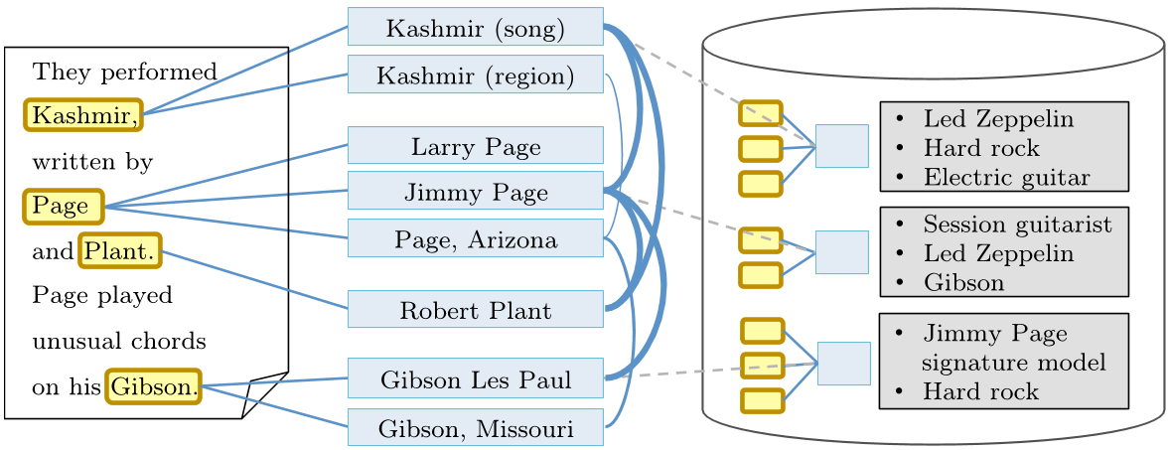
Graph Based Approaches
Example of graph produced by the AIDA system

Slide 21
Graph Based Approaches
Find a subgraph where only one entity-mention edges with maximum weight
This task is a generalized version of the Steiner-tree problem
The task is NP-hard => they use a greedy algorithm

Slide 22
Unsupervised Ranking Methods
VSM based models
Problem: Obtaining a good training data is hard and expensive
We can represent both entities and mentions using vectors (VSM – vector space model)
Pick a similarity measure and choose candidate entity which is the closest to the mention

Slide 23
Unsupervised Ranking Methods
Information Retrieval Based Methods
Each candidate entity is a “document”
Each entity mention is a “query”
Disambiguation: retrieval of the document with the highest relevance
[1] proposes to use the KL-divergence retrieval model where e=entity, m=mention, language models
[1] S. Gottipati and J. Jiang, “Linking entities to a knowledge base with query expansion,” in EMNLP, 2011, pp. 804–813.

Slide 24
Unlinkable Mention Prediction

Slide 25
Unlinkable Mention Prediction
How can we detect the case when none of the candidate entities is suitable?
We can:
Ignore this problem and assume that recall of Candidate Entity Generation is 1
Assume the entity is unlinkable if the entity candidate set is empty
Use a threshold value on the ranking score

Slide 26
Unlinkable Mention Prediction
How can we detect the case when none of the candidate entities is suitable?
We can:
Train a binary classifier
Input <mention, top_entity> output 1 if ok, 0 is bad
Add NIL as a special entity and consider it during the ranking process. If NIL will get the highest score, then the entity is considered unlinkable

Slide 27
State-of-the-Art

Slide 28
State-of-the-Art
Table from M. Cornolti, P. Ferragina, and M. Ciaramita, “A framework for benchmarking entity-annotation systems,” in WWW, 2013, pp. 249–260.

Slide 29
State-of-the-Art
AIDA
Uses YAGO2 as KB, Stanford NER to detect the entities
Works with English and other languages
Offers public web demo https://gate.d5.mpi-inf.mpg.de/webaida/
Public API: curl --data text="Dylan was born in Duluth." https://gate.d5.mpi-inf.mpg.de/aida/service/disambiguate
Now a startup: Ambiverse!

Slide 30
State-of-the-Art
DBPedia Spotlight
Uses DBpedia as KB, LingPipe as NER
Relies on VSM for disambiguation
Works with English and other languages
Offers public web demo https://dbpedia-spotlight.github.io/demo/

